Slide 1
Among Us in Real Life
Exploring the Game Beyond Screens

Slide 2
Concept Overview
Among Us in real life brings the popular digital game into physical settings
Participants play as Crewmates or Impostors just like in the digital version
The game is adapted to include physical tasks and face-to-face interactions
Safety and rules are adjusted to ensure a friendly and engaging environment

Slide 3
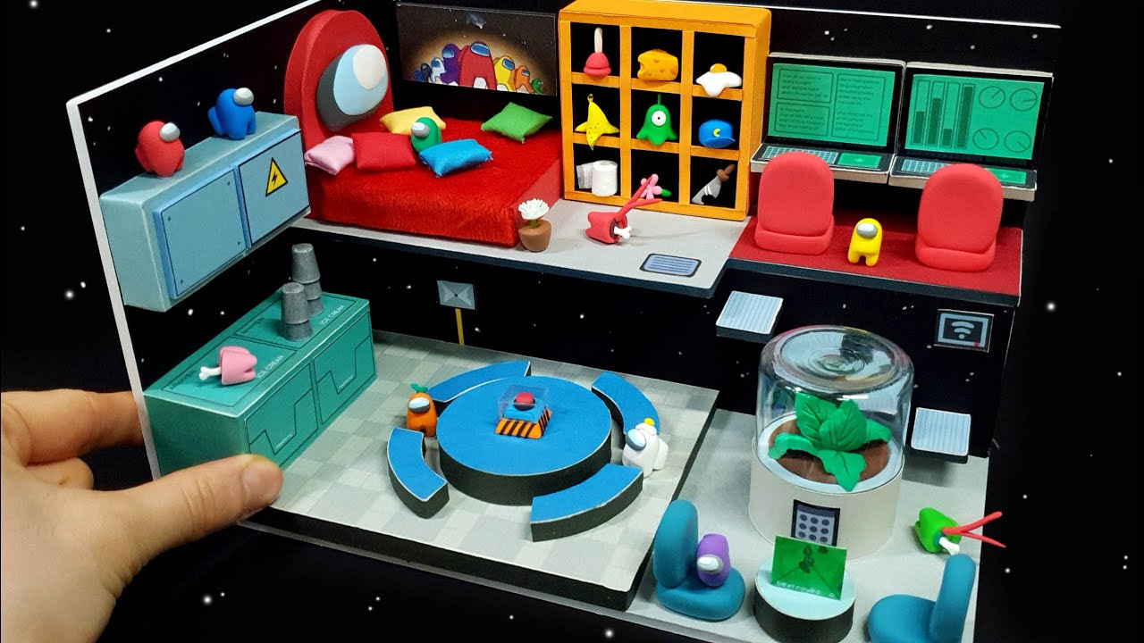
Setting Up the Game
Choosing a suitable location is crucial; spaces like homes, parks, or rented venues work well
Preparing tasks that can be physically completed by players adds to the excitement and challenge

Slide 4
Rules and Roles
Rules need to be clear and understood by all players to maintain fair gameplay
Assigning roles secretly and managing game sessions requires careful coordination
Special equipment like task cards or role badges enhances the real-life experience

Slide 5

Adapting Challenges
Tasks are adapted to be interactive and suitable for the physical environment
Challenges could range from puzzles to simple physical tasks, mimicking the digital game's tasks

Slide 6
Thank You!

